Slide 1
DeepTyper for Python
Travis Chambers

Slide 2
Python Types
https://www.python.org/dev/peps/pep-3107/
https://www.python.org/dev/peps/pep-0484/

Slide 3
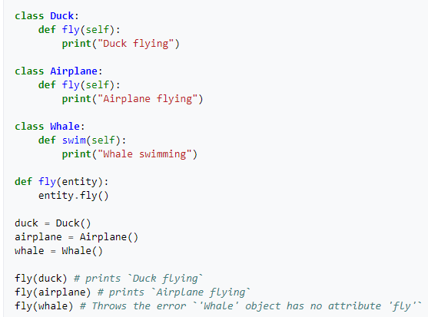
Typing
Type Checking: Static vs Dynamic
Strongly vs Weakly Typed
“3” + 5
Duck Typing
Notes:
Type checking – compile time or run time?
Strongly vs weakly – how easy is it to coerce object into a different type?

Slide 4
Why Typing?
15% of bugs in JavaScript could be prevented by type annotations
Lack of types:
Hard to understand APIs
Difficult to read, maintain, and document
Poor IDE support
Notes:
Gao – To Type or Not to Type: On the Effectiveness of Static Typing for JavaScript 2017 IEEE
How can an IDE suggest autocompletions if it doesn’t know the type? Just suggest all variables in a file?

Slide 5
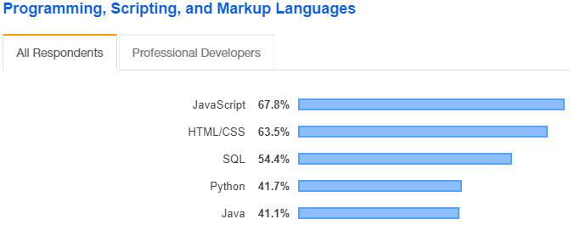
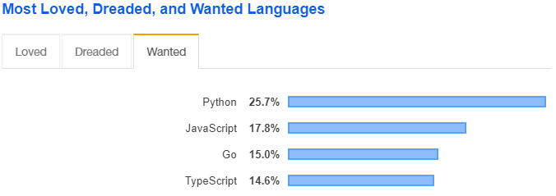
Dynamically Typed Languages
JavaScript -> TypeScript
Python -> typing module
https://insights.stackoverflow.com/survey/2019#technology
Notes:
https://docs.python.org/3/library/typing.html
https://www.python.org/dev/peps/pep-0484/
https://www.python.org/dev/peps/pep-0526/

Slide 6
Python Typing
Poorly adopted
Can decrease readability, one of python’s strongest benefits

Slide 7
Typing Examples
isort - https://github.com/timothycrosley/isort
Tale - https://github.com/irmen/Tale
FastAPI - https://github.com/tiangolo/fastapi

Slide 8
State of Type Hints in Python
https://www.bernat.tech/the-state-of-type-hints-in-python/

Slide 9
Generated Code Corpus
No existing corpus of python code using type hints
Mined GitHub manually
Total typed: 2064
Total typed lines of code: 1,068,993

